Slide 1

AUTOMOBILE
INSURANCE SYSTEM
Presented By
Ashvitha K
Trainer : Mr. Javeed

Slide 2

Project Overview
Developed a full-stack Automobile Insurance System using React 19, Vite, Java 21, Spring Boot 4.1, MySQL, Spring Data JPA, and Hibernate to automate the complete vehicle insurance lifecycle.
Implemented Spring Security, JWT, and BCrypt to provide secure user authentication, role-based authorization, and protected access for both Customer and Admin users.
Enabled customers to browse insurance policies, submit proposals, receive premium quotes, make online payments, download PDF policy certificates using Apache PDFBox, and receive automated email notifications through JavaMailSender.
Built a responsive frontend using React Router DOM, Axios, HTML, CSS, and JavaScript, along with an Admin dashboard to manage users, policies, proposals, quotes, payments, claims, and supporting documents efficiently.

Slide 3
Module Description
Authentication & Security Module:
Provides secure user registration, login, and password recovery functionality.
Uses JWT authentication to secure all protected API endpoints.
Passwords are encrypted using BCrypt before storing them in the database.
Supports role-based access control for Customer and Admin users.
Every authenticated request is validated using a JWT security filter.
Prevents unauthorized users from accessing protected resources.

Slide 4
Module Description
User Module:
Manages customer and admin accounts, including registration, login, profile management, and CRUD operations. Stores user information securely and allows users to access and update only their own profile.
Policy Module:
Maintains the insurance policy catalog with policy details, coverage, vehicle type, and premium. Allows customers to browse policies, while only admins can add, update, or delete policies.

Slide 5
Module Description
Proposal Module:
Allows customers to submit vehicle insurance proposals by providing vehicle and policy details.
Tracks the proposal through different stages such as Submitted, Approved, Rejected, and Active.
Quote Module:
Generates the insurance premium for approved proposals automatically or manually by the admin.
Sends the premium quote to customers through email for payment.

Slide 6
Module Description
Payment Module:
Allows customers to make premium payments using supported payment methods.
Activates the policy after admin approval and generates a PDF policy certificate.
Claim Module:
Enables customers to raise insurance claims against their policies.
Allows admins to review, approve, or reject submitted claims.

Slide 7
Module Description
Document Module:
Allows customers to upload documents such as RC books and driving licenses
Stores and manages all proposal-related documents securely.
Scheduler Module:
Automatically checks policy expiry every day without manual intervention.
Sends expiry reminder emails and updates expired policies automatically.

Slide 8
Application Page Flow
Login / Register – Users create an account or log in securely using JWT authentication.
Dashboard – Customers and Admins are redirected to their respective dashboards after successful login.
Browse Policies – Customers view available insurance policies and select a suitable plan.
Submit Proposal – Customers enter vehicle details and submit an insurance proposal.

Slide 9
Application Page Flow
Quote Generation – Admin approves the proposal, and the system generates the premium quote.
Make Payment – Customers pay the premium using the available payment methods.
Policy Activation – Admin approves the payment, activating the policy and generating a PDF certificate.
Claims & Documents – Customers can raise claims, upload supporting documents, and track claim status.

Slide 10
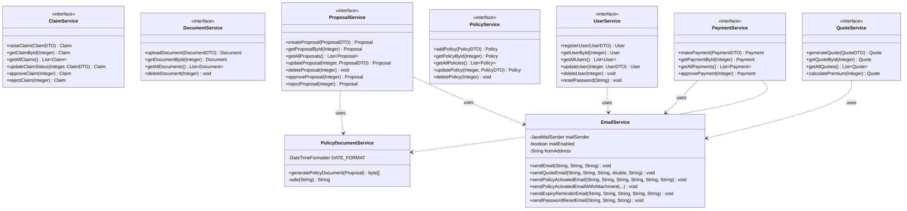
Class Diagram

Slide 11
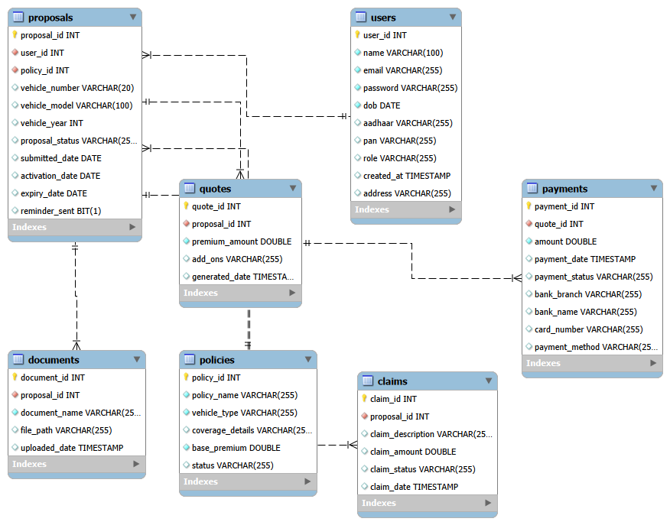
ER Diagram

Slide 12
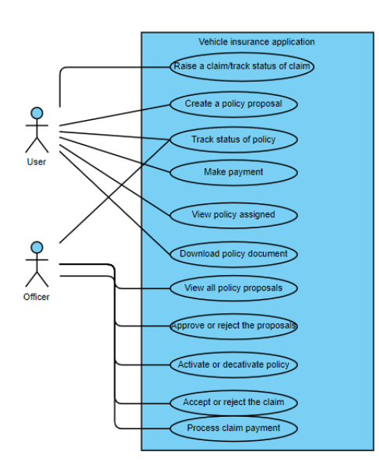
UseCase Diagram
user
admin

Slide 13
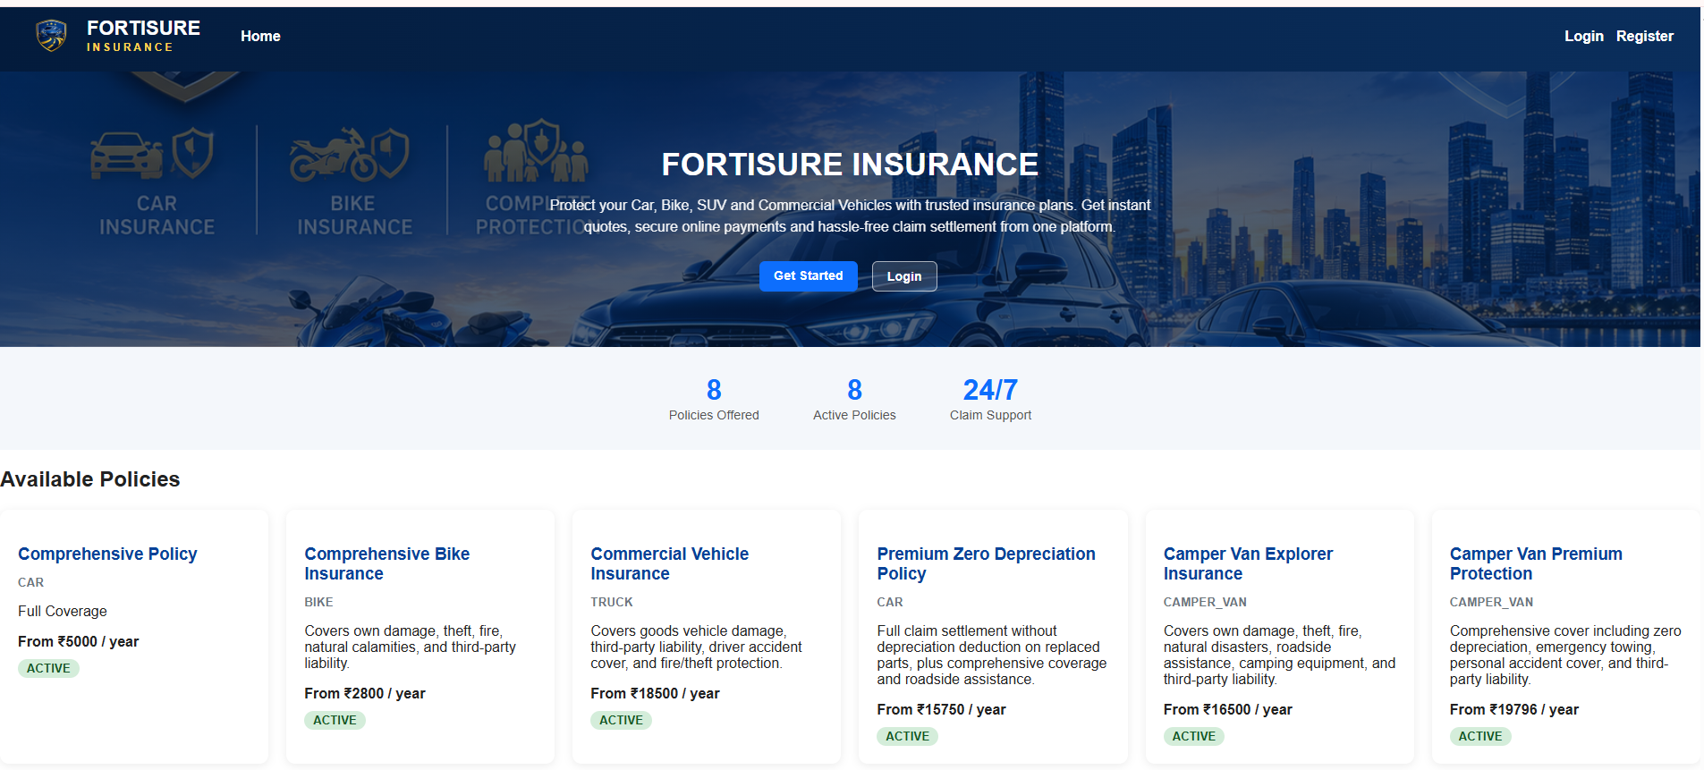
Application Screenshots

Slide 14
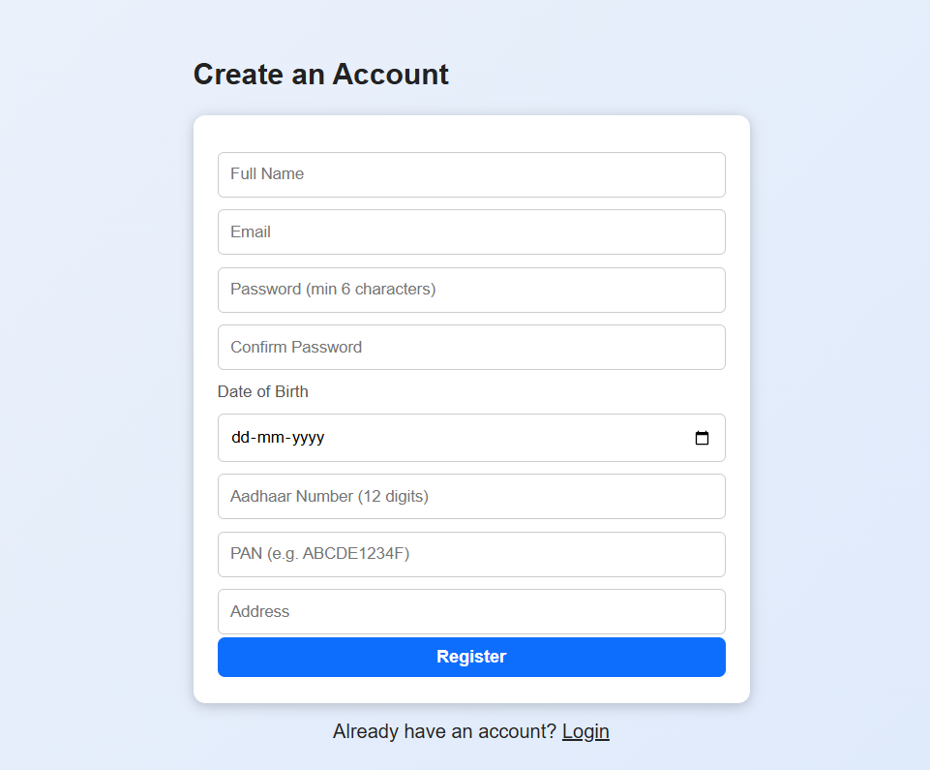
Application Screenshots

Slide 15
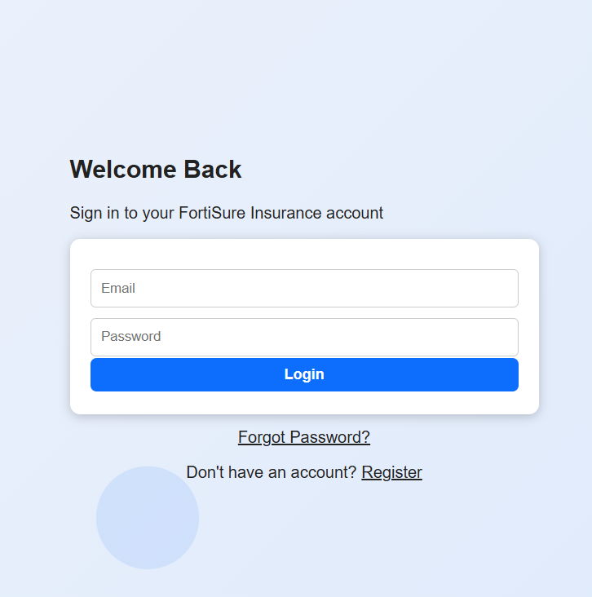
Application Screenshots

Slide 16
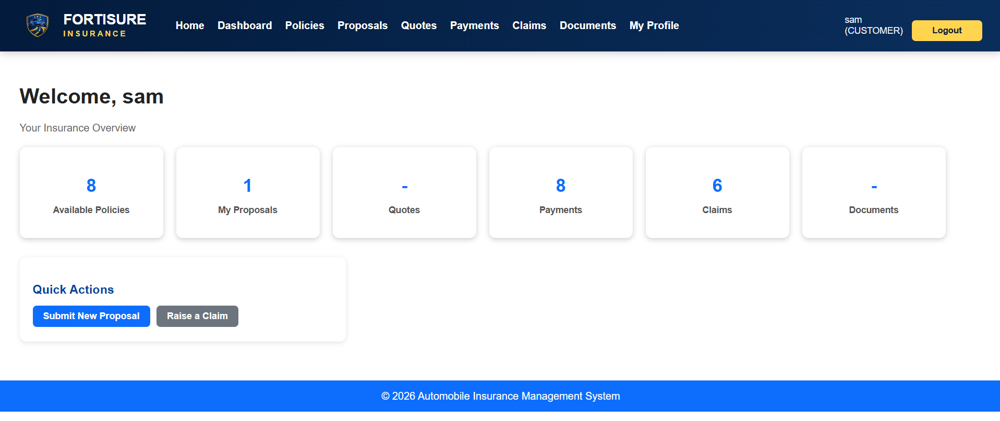
Application Screenshots

Slide 17
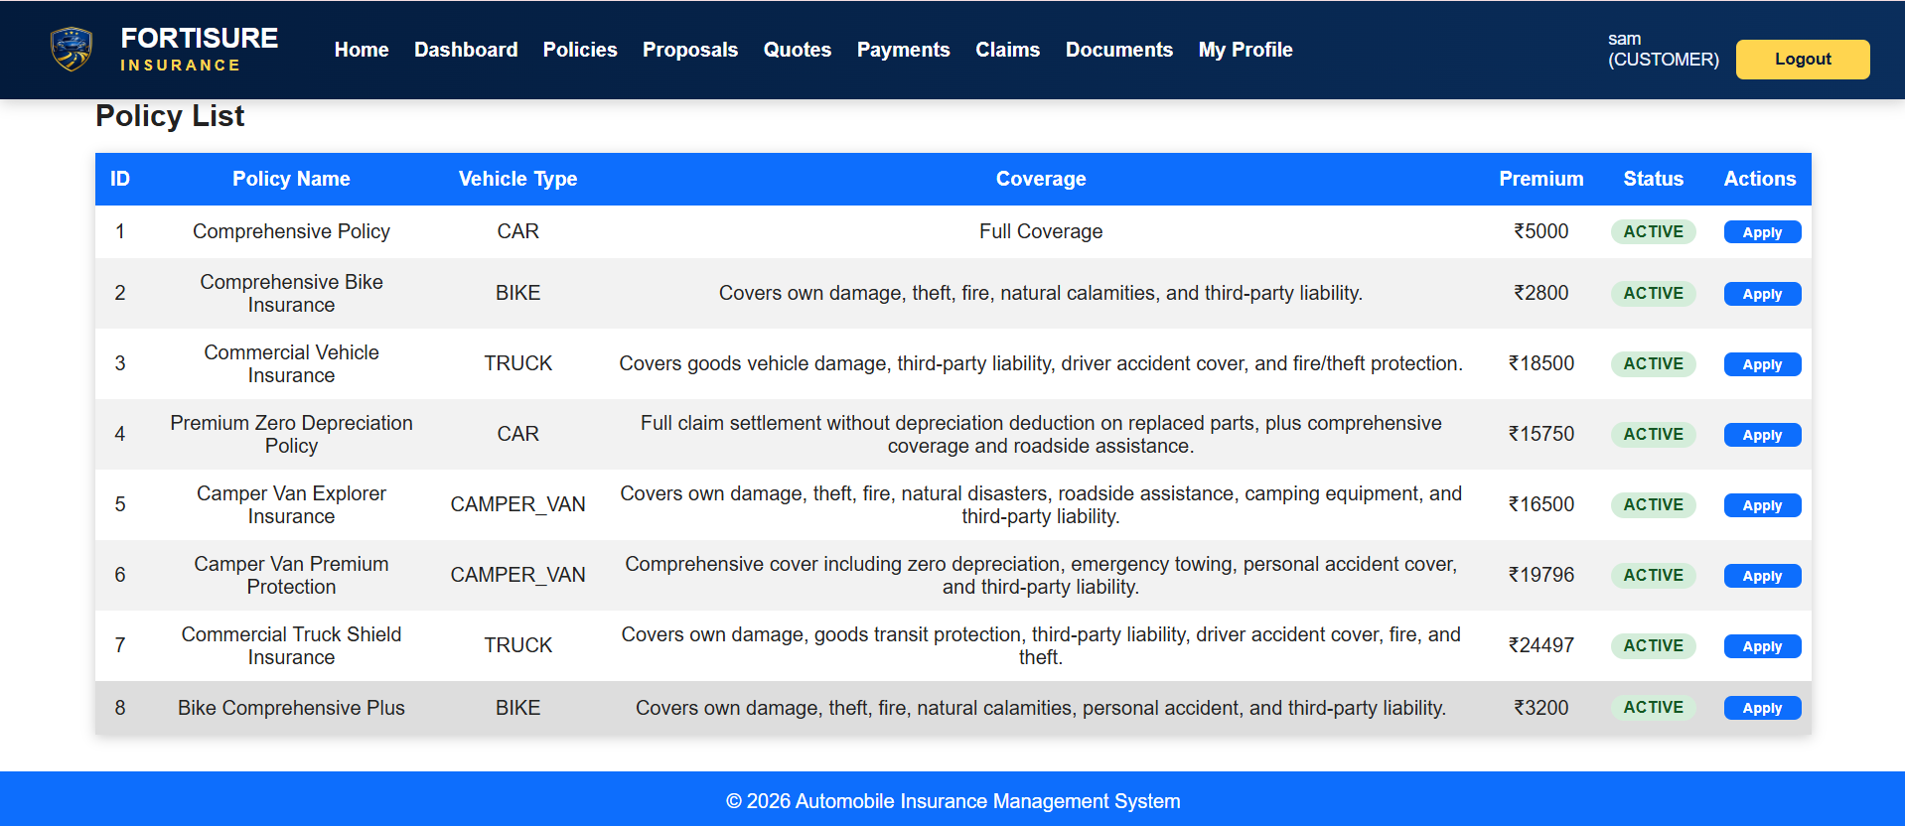
Application Screenshots

Slide 18
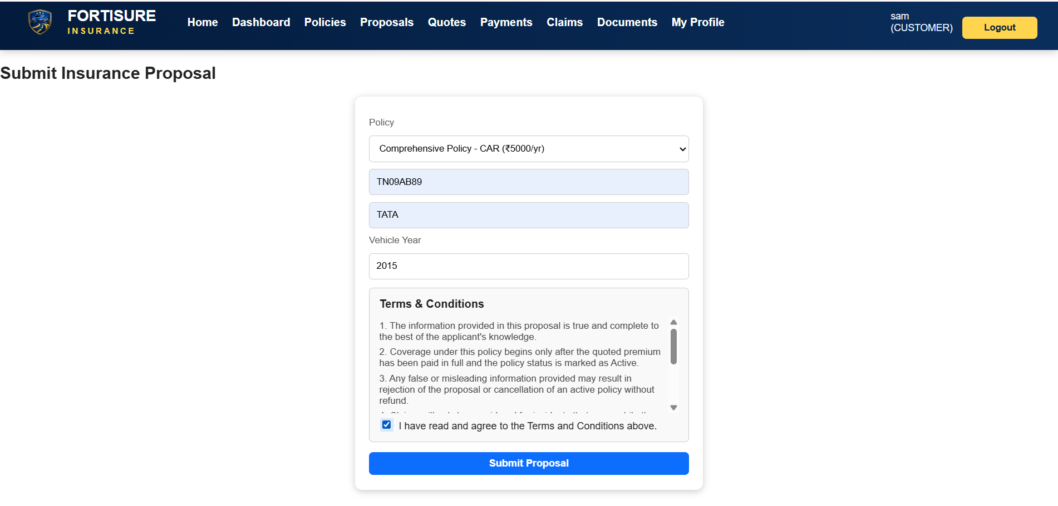
Application Screenshots

Slide 19
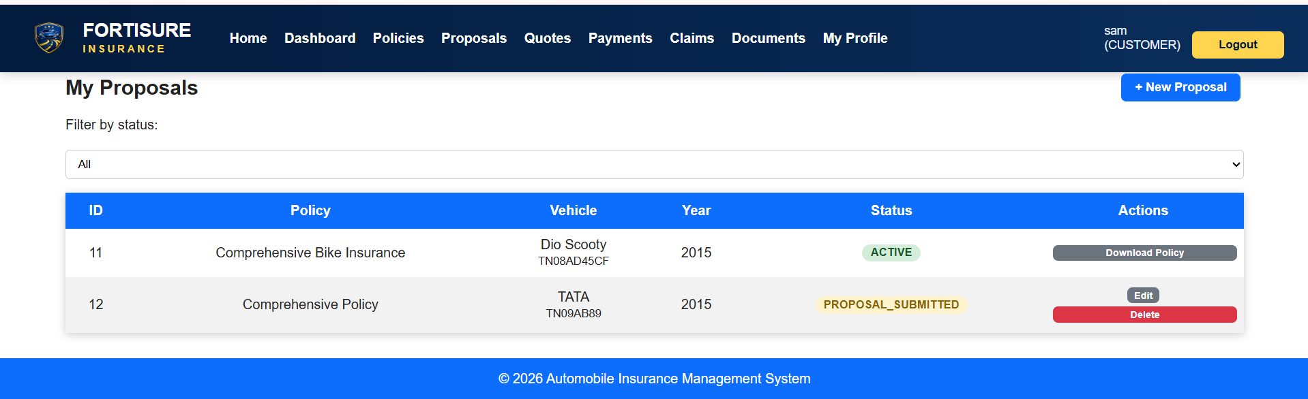
Application Screenshots

Slide 20
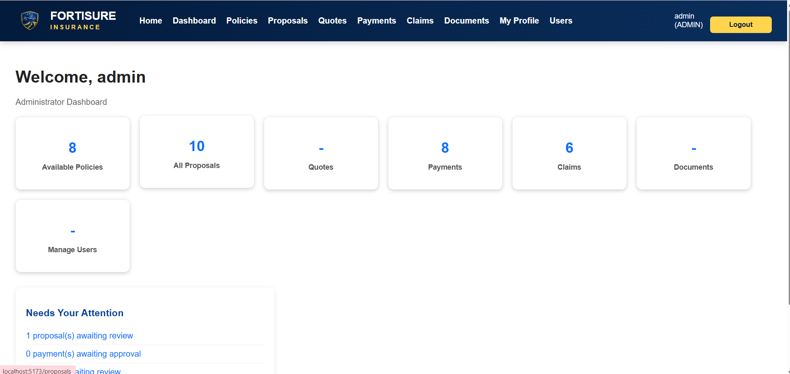
Application Screenshots

Slide 21
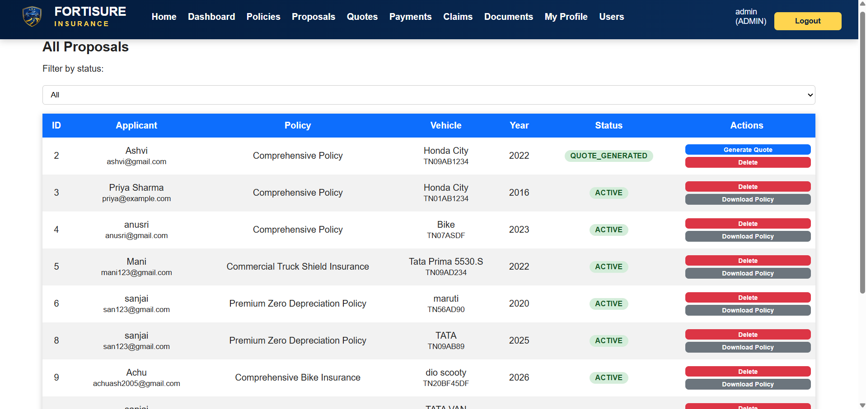
Application Screenshots

Slide 22
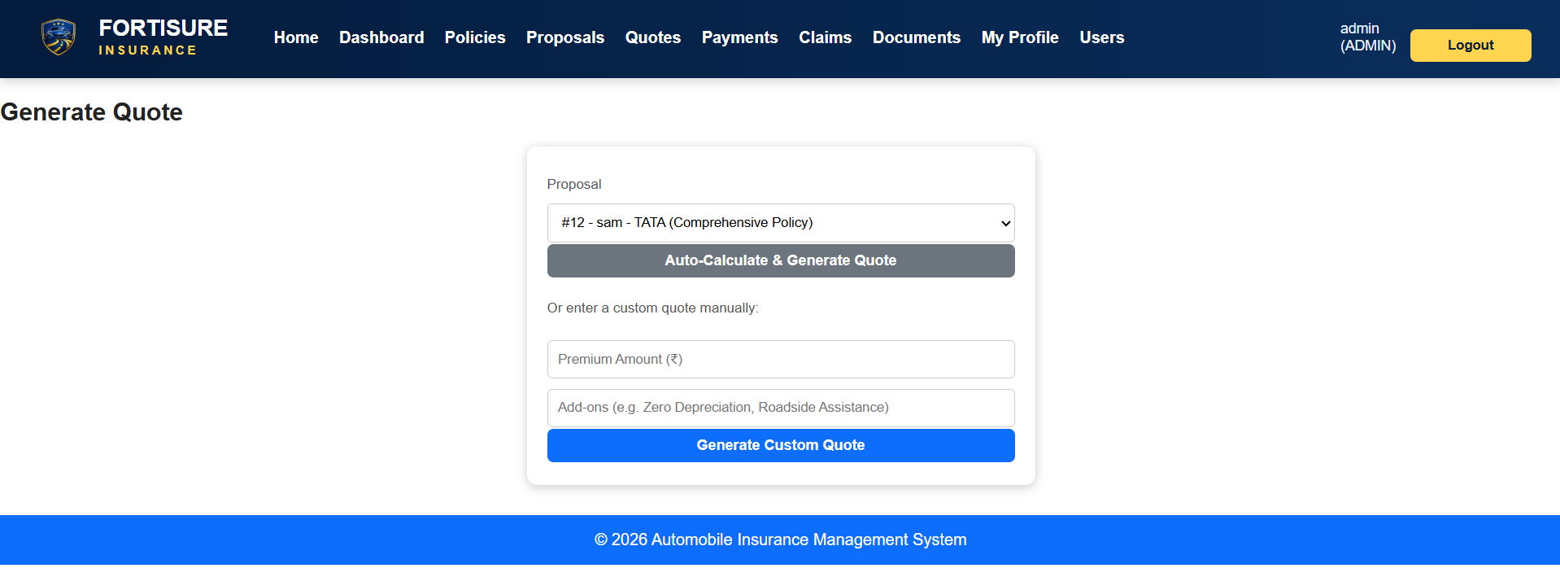
Application Screenshots

Slide 23
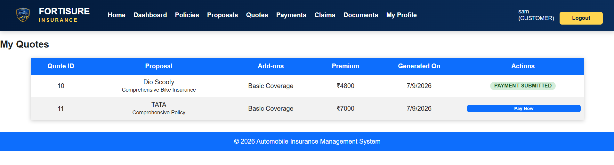
Application Screenshots

Slide 24
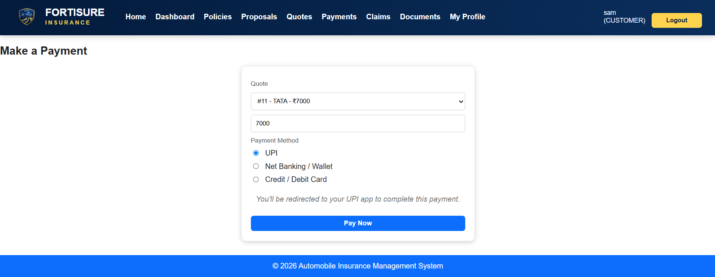
Application Screenshots

Slide 25
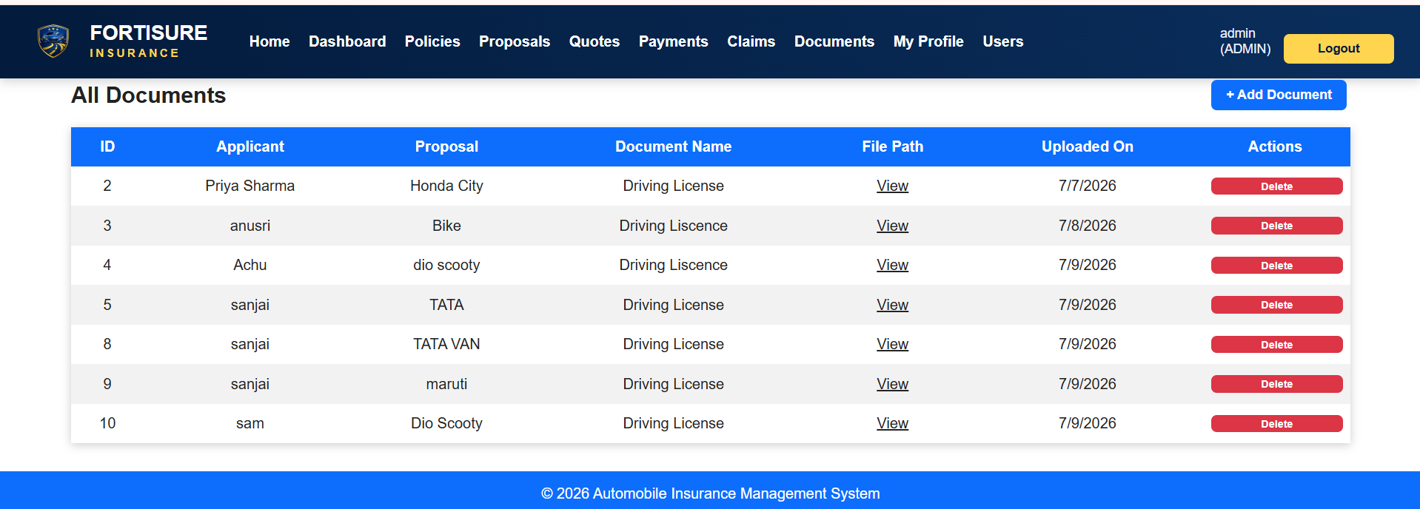
Application Screenshots

Slide 26
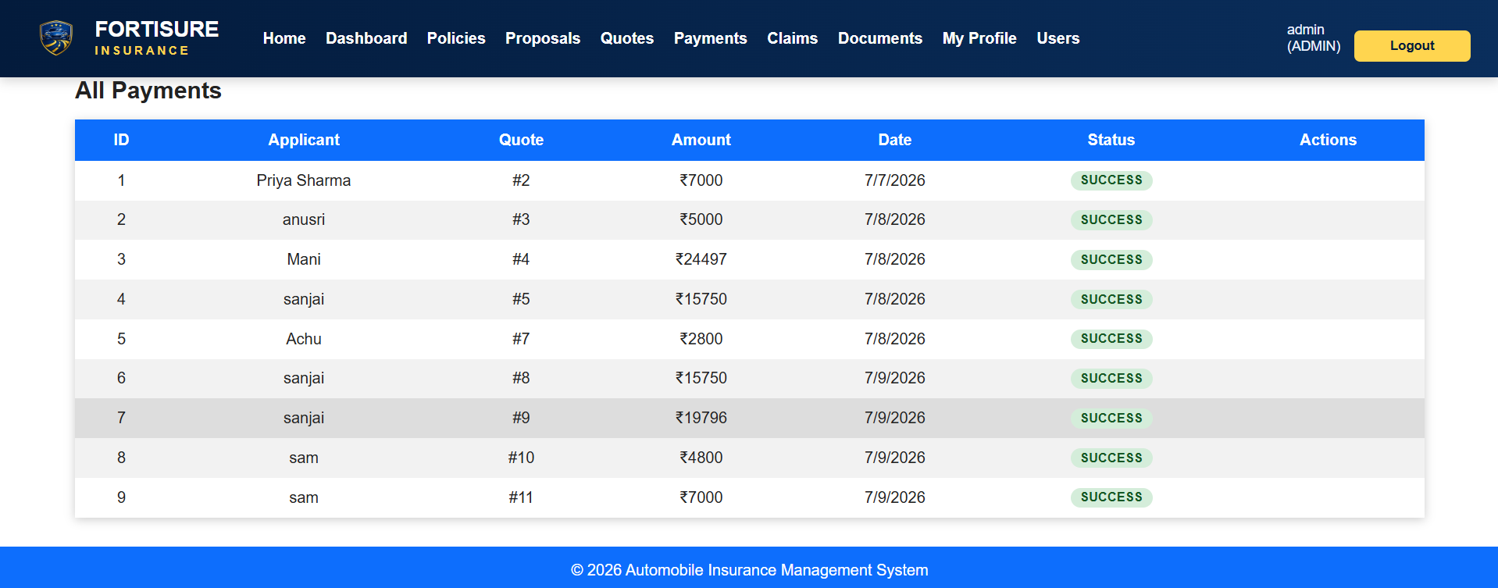
Application Screenshots

Slide 27
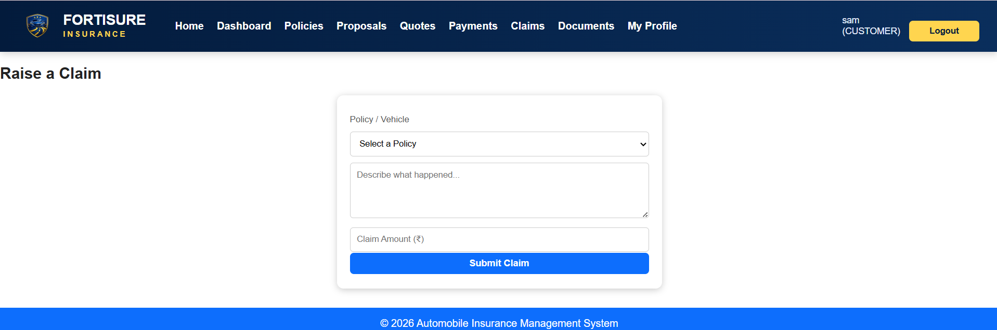
Application Screenshots

Slide 28
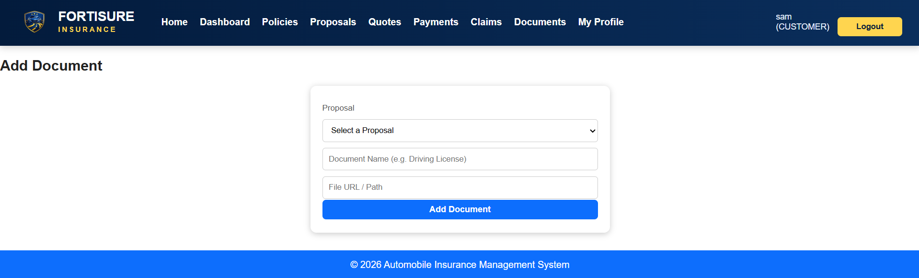
Application Screenshots

Slide 29
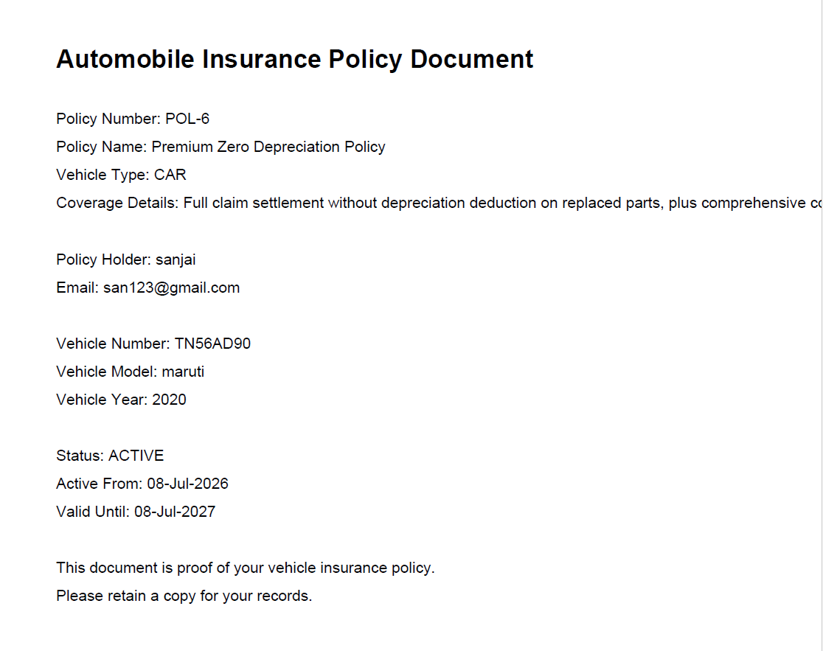
Application Screenshots

Slide 30
THANK YOU

